Slide 1
CLC – Day 4
SQLite & Flask

Slide 2
Database - SQLite
Relational databases provide a way to store structured data in tables and establish relationships between those tables.
They usually use Structured Query Language (SQL) as the primary way to interact with the data.
An SQLite database provides support for interacting with the data table using SQL.
SQL is a declarative language used to create, manage, and query the data contained in a database.

Slide 3
Database With SQL
Data is stored in the database in two-dimensional table structures.
Each table consists of rows of records, and each record consists of columns, or fields, containing data.
The data contained in the fields is of pre-defined types, including text, integers, floats etc.
Each record in the table has a primary key defined to give a record a unique identifier.

Slide 4
Database With SQL
The database engine itself often generates the primary key as an incrementing integer value for every record inserted into the database table.

Slide 5
Creating Tables With SQL
CREATE TABLE IF NOT EXISTS temperature_log (
id INTEGER PRIMARY KEY AUTOINCREMENT,
temperature REAL,
timestamp TEXT
)
The database engine determines how to do this.

Slide 6
SQL
SELECT * FROM temperature_log ;
INSERT INTO temperature_log (temperature, timestamp) VALUES (?, ?)
sqlite3 — DB-API 2.0 interface for SQLite databases — Python 3.14.3 documentation

Slide 7
Python project using SQLite
https://github.com/nisharanipraveen/EnvironmentMonitoringSystem.git

Slide 8
Creating a Flask Web Application
Flask is a powerful and flexible micro web framework for Python.
Ideal for both small and large web projects.

Slide 9
Set up a Flask Project
Create a folder FlaskExample
Open the folder FlaskExample in VS Code
Create a virtual environment (Optional)
python -m venv venv
.\venv\Scripts\activate
Add dependencies
python -m pip install Flask

Slide 10
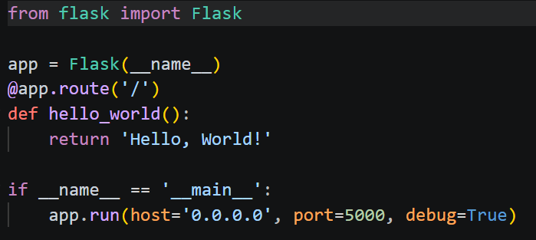
Initiate the Flask project
Create development server and display “Hello World!“ in the browser.
Create a file named app.py inside FlaskExample folder and type in the below code.

Slide 11
Functions like hello_world() are called views in Flask.
Run this file.

Slide 12
Adding Package structure
Create a folder named “EnviornmentMonitor” inside FlaskExample
Move the app.py into EnviornmentMonitor
Rename app.py into __init__.py
FlaskExample/
│
└── Environement Monitor/
└── __init__.py

Slide 13
Run the Flask project using the below command.
python -m flask --app EnvironementMonitor run --port 8000 –debug
You’re telling Flask to look for an app named EnvironementMonitor and serve it in debug mode on port 8000
visit http://localhost:8000

Slide 14
Application Factory
An application factory in Flask is a design pattern that’s highly beneficial for scaling Flask projects.
Instead of having your application’s code at the root level of your __init__.py file, you’ll work with a function that returns your application.

Slide 15
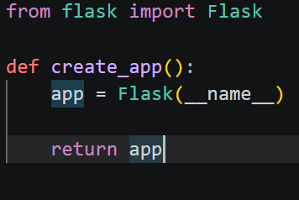
Application Factory
Replace the content of __init__.py with the content below
Function named create_app() initializes the app and returns it.
The create_app() function is your application factory.

Slide 16
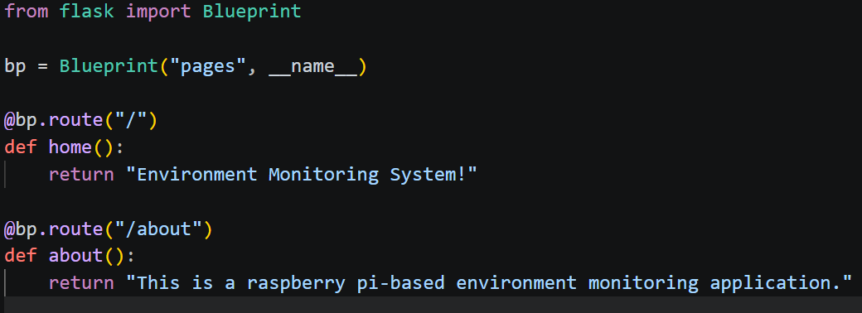
Blueprints
Blueprints are modules that contain related views that you can conveniently import in __init__.py
Create blueprints that you register in your application factory.
Create a file named pages.py in the EnvironmentMonitor/ folder and add the content below

Slide 17

Bp is an instance of Blueprint.
The first argument, "pages", is the name of your blueprint.
You’ll use this name to identify this particular blueprint in your Flask project.
The second argument is the blueprint’s __name__.

Slide 18
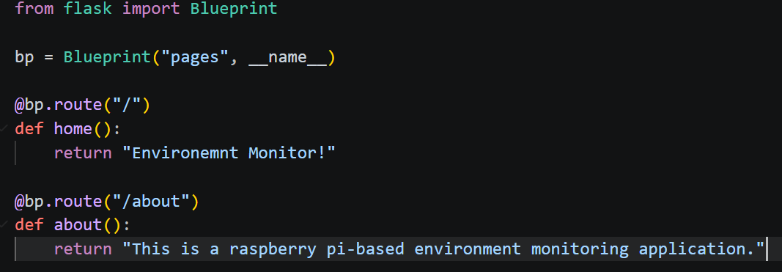
Leverage Blueprints
Blueprints are modules that contain related views that you can conveniently import in __init__.py
Create a file named pages.py in the board/ folder and add the content below:

Slide 19
visit http://localhost:8000/about

Slide 20
Templates
Templates are HTML files with the capability of rendering dynamic content sent over from your Flask views.
Flask uses the popular Jinja template engine, which you already installed as a dependency when you installed Flask.
With a template engine like Jinja, you can embed Python-like expressions into your templates to create dynamic web content
Jinja also supports template inheritance, allowing the creation of a base template that you can extend in child templates.

Slide 21
Git Hub Repository for the template-based Web Application code
https://github.com/nisharanipraveen/FlaskExample.git

Slide 22
Questions

